Slide 1
PROFESSOR VELAZQUEZ
INTRODUCTION
TO
MICROECONOMICS
MODULE 08 · STRUCTURAL INEQUALITY EXTENSIONS
FALL 2025

Slide 2
08
Structural Inequality
Extensions
Module 7 built the mechanisms — poverty traps, monopsony, principal-agent failures. This module applies them to three contemporary structural crises: the digital economy, algorithmic systems, and the climate emergency. Each is a market failure, and each demands a policy response.
MODULE

Slide 3
MODULE 8
Agenda, Big Questions & Opening Inquiry
BIG QUESTIONS
PRE-WORK
WHAT YOU'LL NEED
(1) How does unequal access to digital technology amplify existing economic inequalities — and who bears the cost of the platform economy?
(2) How can algorithmic systems produce discriminatory outcomes even without discriminatory intent — and what corrective mechanisms are available?
(3) Who bears the greatest cost of climate change — and does the distribution of burdens match the distribution of responsibility?
· Review Module 7 in full — every tool used today comes from it
· Review Module 6, Part 6 (the externality diagram) — today is Climate Arc Part 2
· Complete the Module 8 Vocabulary Checklist
· Bring the Module 8 Worksheet and graph paper for the vulnerability scatter
· Module 8 Worksheet (printed)
· Graph paper for the GDP-vs-vulnerability plot
· Your Module 6 externality diagram
· Your Module 7 notes on principal-agent and statistical discrimination
OPENING INQUIRY
Module 7 established the MECHANISMS — poverty traps, monopsony, principal-agent failures. This module applies those tools to three contemporary structural crises: the digital economy, algorithmic systems, and the climate emergency. Each reveals a MARKET FAILURE — and demands a POLICY RESPONSE.
SECTION | PART | WHICH MODULE 7 TOOL DOES THE WORK
I — The digital economy and its discontents | Part 1 · The digital divide and the platform economy | Complementary goods (M3) · VMP (M5) · principal-agent and risk-shifting (M7)
II — Algorithmic bias as market failure | Part 2 · Algorithmic systems, disparate impact and corrective mechanisms | Statistical discrimination and its self-fulfilling loop (M7) · information asymmetry (M7)
III — Climate Arc Part 2: distributional justice | Part 3 · Climate change — who bears the cost? | Negative externality and social cost (M6) · the Great Divergence (M6) · incidence (M4)
INTRO TO MICROECONOMICS | PROF. VELAZQUEZ
MODULE 8: STRUCTURAL INEQUALITY EXTENSIONS

Slide 4
BEFORE WE BEGIN
Vocabulary Checklist — Module 8
Digital Divide
Access Gap
Digital Literacy
Platform Economy
Independent Contractor
Algorithmic Bias
Disparate Impact
Disparate Treatment
Proxy Discrimination
Fairness Constraint
Algorithmic Audit
Climate Justice
Distributional Injustice
Regulatory Failure
Climate Arc — Part 2
Environmental Racism
Sacrifice Zones
Corrective Policy
Green Transition Labor Market
Just Transition Fund
Carbon Dividend
Pigouvian Tax (preview)
Cumulative Emissions
Adaptation vs. Mitigation
Loss and Damage
THE PATTERN TO WATCH FOR IN ALL THREE CASES
In each one, the harm falls on people who are NOT PARTIES to the transaction that produced it, or on people whose CONSTRAINTS were set before they chose anything. That is the definition of a market failure — and it is why all three end in a policy question rather than a market answer.
INTRO TO MICROECONOMICS | PROF. VELAZQUEZ
MODULE 8: STRUCTURAL INEQUALITY EXTENSIONS

Slide 5
SECTION I
The Digital Economy & Its Discontents
Part 1 · The digital divide as a structural amplifier of inequality
Part 1 · The platform economy: classification, risk-shifting and algorithmic management

Slide 6
01
The Digital Divide
& the Platform Economy
PART
OBJECTIVE Analyze the digital divide as an access gap with compounding economic consequences; evaluate platform economy labor conditions through Module 5's factor market models.
INTRO TO MICROECONOMICS | PROF. VELAZQUEZ
MODULE 8: STRUCTURAL INEQUALITY EXTENSIONS

Slide 7
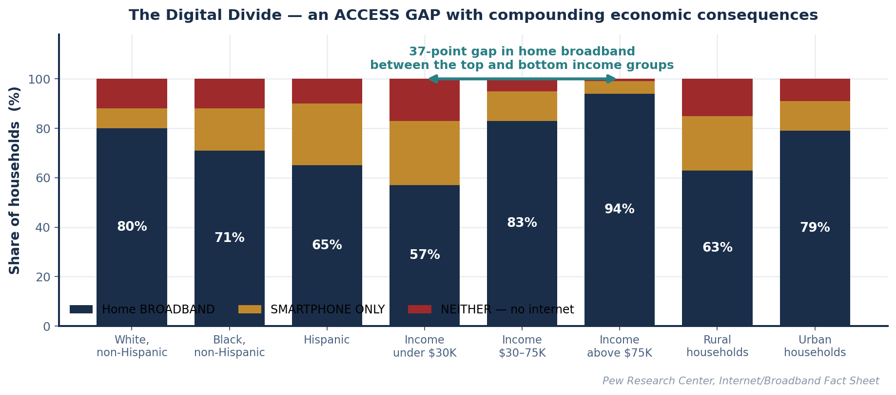
PART 1 · THE DATA
The Digital Divide — Reading the Access Gap
1
WHICH TWO GROUPS FACE THE LARGEST GAP?
2
WHY 'SMARTPHONE ONLY' AT LOW INCOME?
3
BROADBAND AS A COMPLEMENT
Households earning UNDER $30K (57% home broadband) versus households earning ABOVE $75K (94%) — a 37-point gap. On race, the largest gap is White non-Hispanic (80%) versus Hispanic (65%), 15 points. Income is the sharper divider.
A phone is a SUBSTITUTE at a lower price point with a lower fixed cost. Home broadband requires a credit check, a deposit, a 12-month contract and a fixed address — every one of which is a barrier the Module 7 credit desert makes binding. The budget constraint (M1), not the preference, produces the pattern.
If broadband is a COMPLEMENT to education and remote work (M3: ∂D/∂P of the complement < 0), then unequal access to broadband produces UNEQUAL RETURNS to schooling and job search. Human capital accumulation diverges — which is the poverty-trap loop from M7, running through a new channel.
INTRO TO MICROECONOMICS | PROF. VELAZQUEZ
MODULE 8: STRUCTURAL INEQUALITY EXTENSIONS

Slide 8
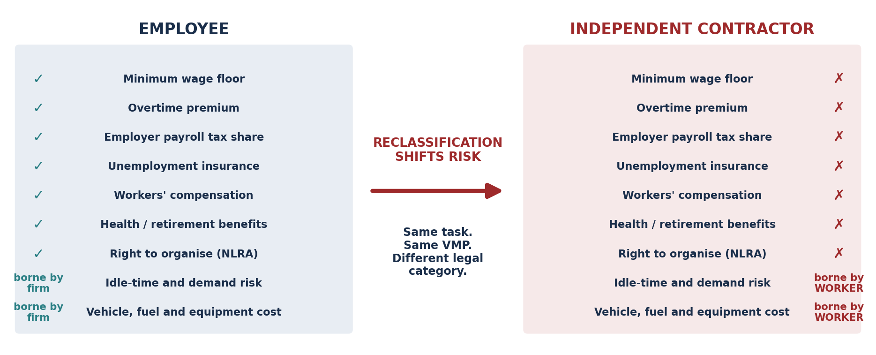
SCENARIO · MARCUS IN THE GIG ECONOMY
Classification, Risk and the Platform
Marcus lacks reliable broadband; his data cap limits his use of delivery platforms and job boards. Meanwhile Ray earns platform revenue from his property on Airbnb.
THE CLASSIFICATION ANSWER
THE TWO INCOME TYPES
THE DIVIDE IN M5 TERMS
Gig workers are classified as INDEPENDENT CONTRACTORS, which means they lack employee protections. This eliminates access to ALL FOUR of: minimum wage, overtime, benefits, and unemployment insurance — the worksheet's 'circle all that apply' is a trick; the answer is all of them.
Marcus's earnings are ORDINARY LABOR INCOME, taxed at ordinary rates plus the full self-employment payroll tax (both halves, because he is his own employer).
Ray's Airbnb receipts are PASSIVE / RENTAL income — generally taxed at LOWER effective rates after depreciation and expense deductions, with no payroll tax at all.
Marcus lacks BROADBAND, which limits access to PLATFORMS, JOB BOARDS AND DIGITAL FINANCIAL SERVICES — reducing his effective VMP in the labor market. His marginal product is unchanged; his ability to CONVERT it into income is not.
INTRO TO MICROECONOMICS | PROF. VELAZQUEZ
MODULE 8: STRUCTURAL INEQUALITY EXTENSIONS

Slide 9
PART 1 · WORKSHEET ✦1
Algorithmic Management as a Principal-Agent Problem
THE QUESTION
Gig platforms use algorithmic scheduling and pay-setting. Apply the principal-agent framework from Module 7: who is the principal, who is the agent, and what is the information asymmetry? How does classification as an independent contractor shift risk from platforms to workers — and what policy intervention would rebalance it?
 | THE STANDARD FRAMING | THE INVERSION THAT MAKES PLATFORMS DIFFERENT
PRINCIPAL | The platform. It delegates delivery to the worker and cannot directly observe effort or care. | The platform observes MORE than a conventional employer: GPS trace, acceptance rate, dwell time, customer rating, second-by-second location.
AGENT | The worker. Classic moral hazard: hidden action after the contract. | The worker is the party facing the asymmetry. They cannot see the pay algorithm, the ranking rule, the surge formula, or why an offer was withheld.
THE ASYMMETRY | Normally runs AGENT → PRINCIPAL (the worker knows their own effort). | Here it runs PRINCIPAL → AGENT. The platform holds the information; the worker faces an opaque counterparty and cannot price the job before accepting it.
THE CONSEQUENCE | Monitoring costs, efficiency wages, piece rates. | The worker cannot compute expected earnings per hour, so they cannot make the Module 2 labor-leisure decision the model assumes they are making.
1
HOW RECLASSIFICATION SHIFTS RISK
2
WHY THE MODEL SAYS THIS MATTERS
3
POLICY INTERVENTIONS THAT REBALANCE
Demand risk, idle time, vehicle depreciation, fuel, insurance, injury and the entire payroll tax move from the FIRM'S balance sheet to the WORKER'S. The firm converts a FIXED cost into a VARIABLE one and keeps the residual — which is exactly the Module 5 definition of what an entrepreneur is paid for.
Risk-bearing is a factor service and it commands a return (M5). A worker who bears entrepreneurial risk but is paid a piece rate is bearing the risk WITHOUT receiving the profit that compensates it. The classification decouples the risk from its payment.
· A THIRD CATEGORY (dependent contractor) carrying a wage floor and portable benefits.
· PORTABLE BENEFIT ACCOUNTS funded pro rata per engagement.
· ALGORITHMIC TRANSPARENCY rules — disclose the pay formula, which removes the asymmetry directly rather than compensating for it.
· ABC-style reclassification tests.
INTRO TO MICROECONOMICS | PROF. VELAZQUEZ
MODULE 8: STRUCTURAL INEQUALITY EXTENSIONS

Slide 10
SECTION II
Algorithmic Bias as Market Failure
Part 2 · How machine learning trained on historical data reproduces and amplifies discrimination
Part 2 · Disparate impact, proxy discrimination, and why 'objective' is not the same as 'fair'
Part 2 · Corrective mechanisms: fairness constraints, algorithmic audits, and data interventions

Slide 11
02
Algorithmic Systems,
Disparate Impact & Correction
PART
OBJECTIVE Examine algorithmic bias as a market failure; explain disparate impact and proxy discrimination; evaluate the available corrective mechanisms.
INTRO TO MICROECONOMICS | PROF. VELAZQUEZ
MODULE 8: STRUCTURAL INEQUALITY EXTENSIONS

Slide 12
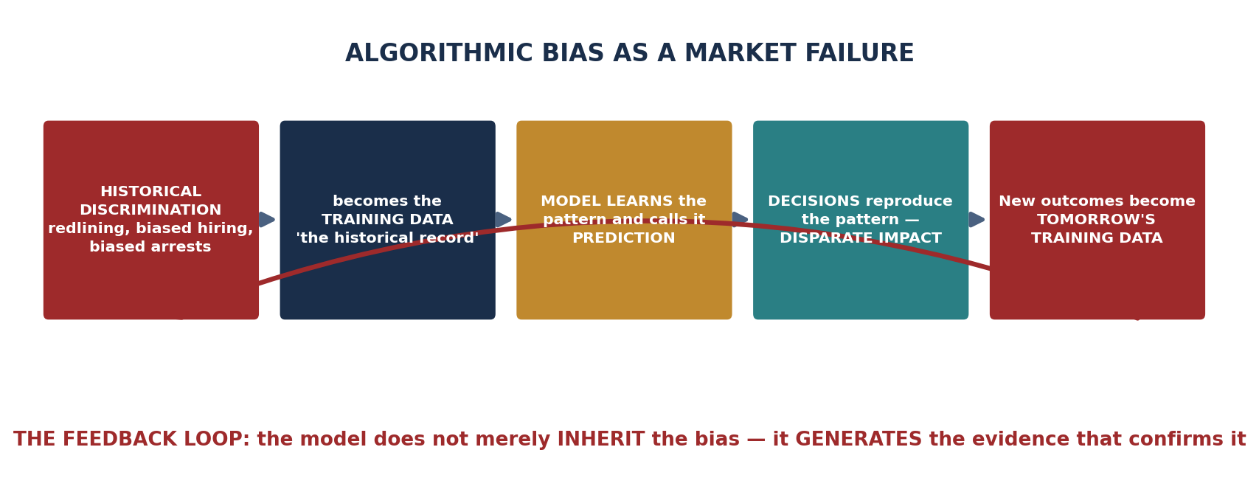
SCENARIO · CREDIT SCORING IN MARCUS'S NEIGHBORHOOD
How an Unbiased Algorithm Produces a Biased Outcome
A fintech lender deploys an algorithm trained on historical loan performance data. Because that data reflects decades of redlining and discriminatory lending, the algorithm assigns lower credit scores to residents of majority-Black neighborhoods — INDEPENDENTLY of individual creditworthiness.
DISPARATE IMPACT
PROXY DISCRIMINATION
WHY IT IS A MARKET FAILURE
An algorithm produces discriminatory outcomes without discriminatory INTENT, because it optimizes against data that already encodes the discrimination.
Compare DISPARATE TREATMENT — the explicit use of a protected characteristic. The law reaches both, but only treatment requires intent.
ZIP code — or browsing history, or high-school attended, or first name — is correlated with race BECAUSE OF THE HISTORY OF SEGREGATION. Using it as a predictor therefore reproduces the racial pattern without ever naming race.
Removing the race variable does NOT remove the effect; it merely removes the audit trail.
Information — the historical record — is SYSTEMATICALLY BIASED, so it leads to MISPRICING. Creditworthy borrowers are charged above their true risk and denied credit whose return exceeds its cost.
That is a real efficiency loss, not only an equity loss: productive investment goes unfunded (M2, M5).
INTRO TO MICROECONOMICS | PROF. VELAZQUEZ
MODULE 8: STRUCTURAL INEQUALITY EXTENSIONS

Slide 13
PART 2 · FOUR APPLICATIONS
Where the Same Mechanism Recurs
ALGORITHMIC APPLICATION | SOURCE OF BIAS | AFFECTED POPULATION & MECHANISM
Mortgage credit scoring | Historical redlining data — decades of denied loans recorded as 'no repayment history' | Residents of formerly redlined neighborhoods. Absence of a credit record is scored as RISK rather than as MISSING DATA, so the algorithm converts a historical injustice into a present-day price. Thin-file borrowers are penalized for having been excluded.
Resume screening (NLP) | Historically biased hiring records — the model learns to predict 'who was hired before' | Women and minority applicants in fields with historically skewed hiring. The model learns proxies (a college, a hobby, a name pattern, an employment gap) and reproduces the historical composition. It optimizes for RESEMBLANCE TO PAST HIRES, not for productivity.
Predictive policing | Historically biased arrest records — arrests measure ENFORCEMENT, not offending | Over-policed neighborhoods. More patrols produce more arrests, which the model reads as more crime, which justifies more patrols. This is the tightest version of the feedback loop: the model's own output becomes its next input.
Healthcare resource allocation | Proxy: historical healthcare SPENDING used as a stand-in for health NEED | Patients with less access to care. Because less was historically spent on them — for reasons of access, not of health — the algorithm infers they are healthier and allocates less care. Obermeyer et al. (2019) documented exactly this in a system covering 200 million people.
THE COMMON STRUCTURE — AND THE ONE-SENTENCE VERSION
In every row, a variable that MEASURES A PAST INSTITUTIONAL CHOICE is treated as if it measured an INDIVIDUAL PROPERTY. Arrests are read as offending; spending is read as need; past hires are read as merit; absence of a loan record is read as unreliability.
AN ALGORITHM CANNOT DISTINGUISH A PATTERN CAUSED BY THE WORLD FROM A PATTERN CAUSED BY THE INJUSTICE THAT PRODUCED THE DATA. That distinction is a causal claim, and causal claims come from theory and history — not from optimization.
INTRO TO MICROECONOMICS | PROF. VELAZQUEZ
MODULE 8: STRUCTURAL INEQUALITY EXTENSIONS

Slide 14
PART 2 · WORKSHEET ✦2
Evaluating Two Corrective Mechanisms
THE QUESTION
Algorithmic systems are often presented as objective — but 'objective' optimization of biased historical data systematically reproduces past injustice. Identify the specific mechanism by which historical redlining data produces present-day credit score disparities. Then evaluate FAIRNESS CONSTRAINTS and ALGORITHMIC AUDITS in terms of both effectiveness and feasibility.
FAIRNESS CONSTRAINTS
ALGORITHMIC AUDITS
WHAT IT IS: a mathematical condition imposed on the model — equalized odds, demographic parity, or calibration within groups — enforced during training.
EFFECTIVENESS: HIGH and direct. It changes the model's output, not merely our knowledge of it, and it works ex ante rather than after harm.
FEASIBILITY PROBLEMS: (1) the fairness definitions are MUTUALLY INCOMPATIBLE — Kleinberg et al. (2016) proved you cannot satisfy calibration and equalized odds simultaneously when base rates differ, so a normative choice is unavoidable and cannot be delegated to the engineer; (2) enforcing them may require USING the protected attribute, which is legally fraught; (3) it usually costs some predictive accuracy, and someone must decide how much is acceptable.
WHAT IT IS: systematic ex-post testing of outcomes by group — paired testing, disparity ratios, adverse-impact ratios — conducted internally or by a regulator.
EFFECTIVENESS: MODERATE. An audit DETECTS disparate impact but does not by itself REMOVE it; it must be coupled to an enforcement remedy or it is documentation.
FEASIBILITY: HIGHER than constraints. It requires no change to proprietary model internals, fits existing disparate-impact law, and can be mandated by a regulator without technical prescription. NYC Local Law 144 (2023) requires exactly this for automated hiring tools.
THE CATCH: audits need demographic data the firm often does not legally hold.
The honest summary: CONSTRAINTS are more EFFECTIVE and less FEASIBLE. AUDITS are more FEASIBLE and less EFFECTIVE.
A serious policy uses both — audits to create the obligation and the evidence, constraints to satisfy it. And note that neither touches the underlying cause:
the DATA is biased because the WORLD was. Debiasing the model is treatment; changing what generates the data is the cure.
INTRO TO MICROECONOMICS | PROF. VELAZQUEZ
MODULE 8: STRUCTURAL INEQUALITY EXTENSIONS

Slide 15
SECTION III
Climate Arc Part 2 · Distributional Justice
Part 3 · Who bears the cost of climate change — and does it match who caused it?
Part 3 · Environmental racism, sacrifice zones, and the green transition labor market
Recall · Module 6 established the MECHANISM. Module 12 evaluates the POLICY.

Slide 16
03
Climate Change —
Who Bears the Cost?
PART
OBJECTIVE Analyze the distributional injustice of climate change; connect it to environmental racism and to policy design; evaluate two corrective instruments.
INTRO TO MICROECONOMICS | PROF. VELAZQUEZ
MODULE 8: STRUCTURAL INEQUALITY EXTENSIONS

Slide 17
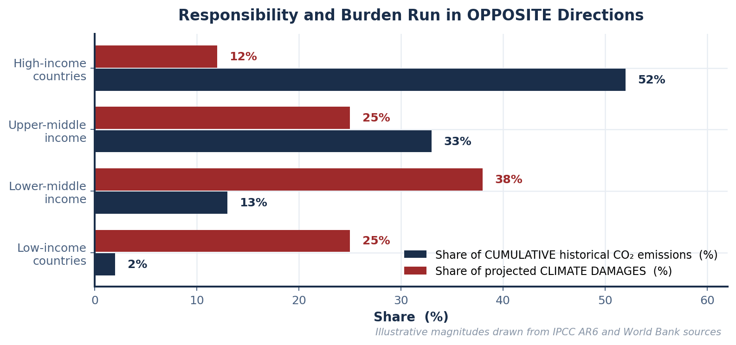
SCENARIO · MARCUS'S NEIGHBORHOOD & THE GLOBAL SOUTH
Environmental Racism and Sacrifice Zones
Marcus's neighborhood sits adjacent to an industrial facility; residents experience higher rates of asthma, lead exposure and heat-island effects. Simultaneously, Pacific Island communities facing existential sea-level rise have contributed a negligible fraction of cumulative global carbon emissions.
ENVIRONMENTAL RACISM
SACRIFICE ZONES
WHY THE MARKET CANNOT FIX IT
The systematic siting of hazardous facilities and infrastructure in low-income and minority communities.
THE ECONOMIC MECHANISM: land is cheapest where incomes are lowest (M5), and political resistance is weakest where political power is least. A firm minimizing cost will site there — no animus required, exactly as with statistical discrimination.
Causation also runs the other way: siting depresses land values, which sorts lower-income residents in. Bullard (1990).
Communities located near EXTRACTIVE OR POLLUTING INFRASTRUCTURE that bear CONCENTRATED environmental costs which are diffused as DISPERSED economic benefits across the wider society.
This is the externality diagram of Module 6 with a MAP attached. The DWL triangle you drew has an address — and it is not the address of the people consuming the output.
The affected residents are NOT PARTIES to the transaction between the refinery and its customers. They have no price at which to refuse, and no standing in the market that produced the harm.
A Coasean bargain (M12) requires clearly assigned rights and low transaction costs. Here there are thousands of affected parties, diffuse harms and contested causation — the three conditions under which Coase explicitly said bargaining fails.
THE DISTRIBUTIONAL INJUSTICE, STATED PRECISELY
The correlation between historical carbon emissions and climate vulnerability is NEGATIVE — and strongly so. The countries and communities that emitted the MOST bear the LEAST physical risk, and those that emitted the LEAST bear the MOST.
This is not an accident of the externality. It follows from it: the wealth that came from burning the carbon is the same wealth that buys sea walls, air conditioning, crop insurance and relocation.
INTRO TO MICROECONOMICS | PROF. VELAZQUEZ
MODULE 8: STRUCTURAL INEQUALITY EXTENSIONS

Slide 18
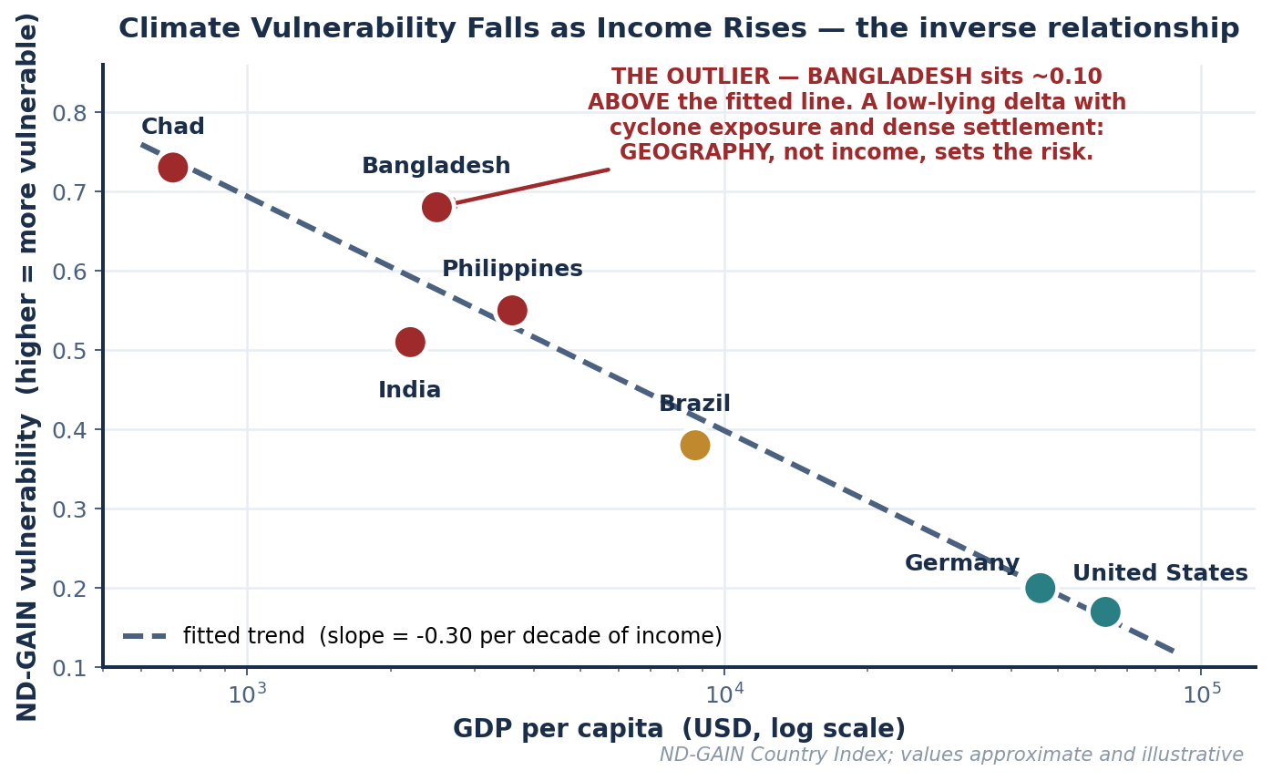
PART 3 · THE DATA
Income and Climate Vulnerability
1
THE RELATIONSHIP
INVERSE and strong. As GDP per capita rises, the ND-GAIN vulnerability score falls — roughly 0.30 points per tenfold increase in income across these seven countries. Chad ($700, 0.73) and the United States ($63,000, 0.17) sit at opposite ends of both variables.
2
THE OUTLIER
BANGLADESH — about 0.10 ABOVE the fitted line. A middle-low-income country can face disproportionate vulnerability when GEOGRAPHY dominates: a low-lying delta, cyclone exposure, dense coastal settlement. Income buys ADAPTIVE CAPACITY but cannot relocate a river delta. The Philippines is the same story in milder form.
3
THE PIGOUVIAN TAX, APPLIED GLOBALLY
A Pigouvian tax internalizes the externality by making the EMITTER pay the social cost. Applied globally it would work in EFFICIENCY terms — emissions would fall toward Q* (M6).
BUT: the revenue accrues to the TAXING JURISDICTION, which is the high-income emitter. The damage accrues elsewhere. The tax corrects the QUANTITY distortion and leaves the DISTRIBUTIONAL problem entirely untouched — unless the revenue is deliberately transferred. That gap is precisely what 'loss and damage' finance is trying to close.
INTRO TO MICROECONOMICS | PROF. VELAZQUEZ
MODULE 8: STRUCTURAL INEQUALITY EXTENSIONS

Slide 19
PART 3 · THE TRANSITION
The Green Transition Labor Market
 | FOSSIL FUEL JOB LOSSES | RENEWABLE ENERGY JOB GAINS | THE TRANSITION GAP
WHERE | Geographically CONCENTRATED — Appalachian coal counties, Gulf refining corridors, Permian and Bakken basins. Often a single-employer local economy. | Geographically DISPERSED and largely ELSEWHERE — solar in the Southwest, wind in the Plains, manufacturing wherever the plant is sited. | A worker cannot commute from a coal county to a solar farm. Module 5's factor-mobility determinant of PES applies directly: labor is not mobile in the short run.
WHO | Older, unionized, high-wage-relative-to-local-median, with deep firm- and industry-SPECIFIC human capital. | Younger, largely non-union, with different and often lower-wage skill profiles at entry. | Specific human capital has near-zero VMP outside its industry. The worker's MP does not transfer, so neither does the wage.
WHEN | FAST — a plant closes on a date. | SLOW — build-out takes years and follows capital, not displaced workers. | The timing mismatch is the whole problem. Aggregate job counts can balance while every individual transition fails.
WHY 'THE MARKET WILL REALLOCATE THEM' IS NOT AN ANSWER
It is the correct LONG-RUN prediction and an inadequate SHORT-RUN policy. Module 1 defined the long run as the horizon over which all factors are variable — but a fifty-two-year-old refinery operator does not live in the long run. The adjustment cost is real, it is concentrated, and the model that predicts eventual reallocation says nothing about who pays for the interval.
WHY THIS IS ALSO A POLITICAL-ECONOMY FACT
Because losses are CONCENTRATED and gains are DIFFUSE, the losers organize and the winners do not — the standard collective action asymmetry from Module 7, Part 5. This is why climate policy is politically harder than its aggregate benefit-cost ratio suggests, and why compensation is not merely fair but STRATEGICALLY NECESSARY to assemble a coalition that can pass anything at all.
INTRO TO MICROECONOMICS | PROF. VELAZQUEZ
MODULE 8: STRUCTURAL INEQUALITY EXTENSIONS

Slide 20
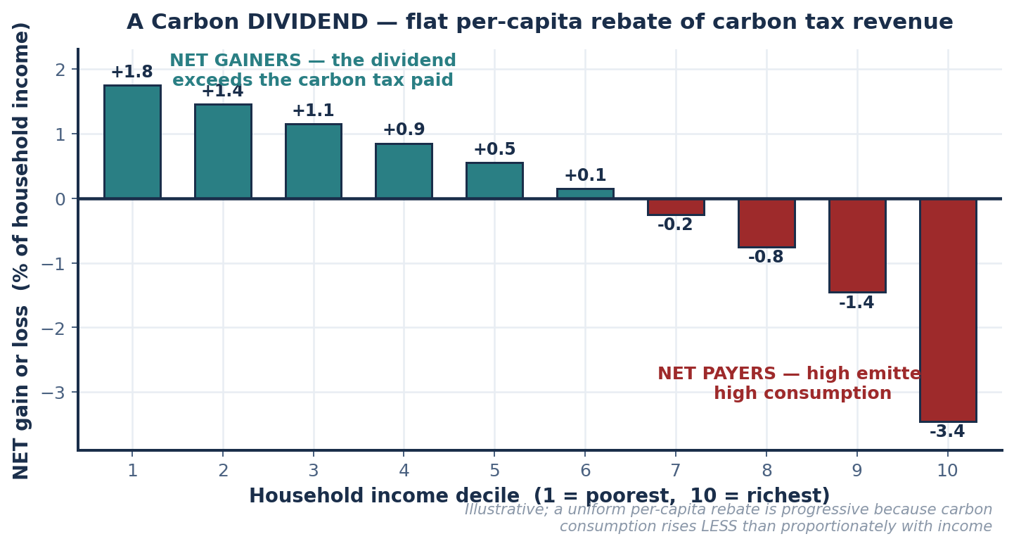
PART 3 · WORKSHEET ✦3
Two Instruments: The Carbon Dividend & the Just Transition Fund
CARBON DIVIDEND
MECHANISM: levy a carbon tax at the social cost of carbon, then return 100% of the revenue as an EQUAL PER-CAPITA payment.
EFFICIENCY (the M6 failure): FULLY ADDRESSED. The tax raises the private cost to the social cost, so Q falls from Q_market to Q*. Crucially, the rebate does NOT undo this — the marginal incentive to emit is set by the TAX, while the rebate is a lump sum independent of your own emissions.
EQUITY (the M8 failure): STRONGLY PROGRESSIVE within a country. Carbon consumption rises less than proportionately with income, so a flat rebate exceeds the tax paid for roughly the bottom six deciles.
JUST TRANSITION FUND
MECHANISM: direct spending on wage insurance, retraining, pension bridging, and regional development in affected communities.
EFFICIENCY: DOES NOT address the externality at all. It changes no emitter's marginal cost and moves Q not at all. It is not a substitute for a price.
EQUITY: ADDRESSES A DIFFERENT AND NARROWER FAILURE — the concentrated adjustment cost borne by displaced workers, which the dividend does not reach because a flat per-capita rebate is far too small to replace a lost career.
THE VERDICT THE WORKSHEET IS LOOKING FOR
READ THE CHART CAREFULLY
They are COMPLEMENTS, not substitutes, because they correct DIFFERENT failures. The dividend fixes the price and the general distributional incidence; the fund fixes the concentrated, geographic adjustment cost. Neither addresses the INTERNATIONAL injustice — that requires cross-border transfer, which no domestic instrument can deliver.
The bars show NET position as a share of household income. Deciles 1–6 are net gainers; 7–10 are net payers. The instrument is progressive WITHOUT any means test — the progressivity comes from the flat rebate meeting a less-than-proportional tax base.
INTRO TO MICROECONOMICS | PROF. VELAZQUEZ
MODULE 8: STRUCTURAL INEQUALITY EXTENSIONS

Slide 21
YOU TRY
Module 8 — Independent Practice
Complete all three Parts of the Module 8 Worksheet, including both data tables and the GDP-versus-vulnerability plot.
Plot the seven countries by hand, sketch the trend, and identify the residual outlier — then justify your choice with a mechanism, not just a position.
Fill in the four-row algorithmic applications table with a specific affected population and a specific causal mechanism for each.
Answer reflection questions ✦1 through ✦3 in complete sentences. Each asks you to name a policy instrument AND the failure it corrects.
This module and Module 7 together are the structural half of the course. Bring both worksheets to the Module 12 Policy Lab.
25
MIN
INTRO TO MICROECONOMICS | PROF. VELAZQUEZ

Slide 22
MODULE 8
What You Should Be Able to Do
 | LEARNING OUTCOME
Part 1 | Read the digital-divide data and identify the largest access gaps by income and by race; explain 'smartphone only' as a budget-constraint outcome rather than a preference; apply the complementary-goods logic to predict divergence in human capital; state all four protections lost by contractor classification; contrast labor income with passive platform income; apply the principal-agent frame to algorithmic management and explain why the asymmetry runs from PRINCIPAL to AGENT; name three rebalancing policies.
Part 2 | Define disparate impact, disparate treatment and proxy discrimination; explain why deleting the race variable does not remove the effect; trace the algorithmic feedback loop through all five stages; give a specific mechanism for each of the four applications; state the effectiveness-versus-feasibility trade-off between fairness constraints and audits, and explain why the fairness definitions cannot all be satisfied at once.
Part 3 | Define environmental racism and sacrifice zones and give the cost-minimizing siting mechanism; describe the inverse income-vulnerability relationship and identify the residual outlier with a geographic explanation; explain why a global Pigouvian tax corrects efficiency but not distribution; describe the green-transition gap in space, in skills and in time; evaluate the carbon dividend and the just transition fund against BOTH the efficiency failure and the equity failure.
NEXT
MODULE 9 — FIRMS AND THE COST OF PRODUCTION. We have spent two modules on distribution. Now we open the firm itself, derive the cost curves, and build the supply side we have been assuming since Module 3.
INTRO TO MICROECONOMICS | PROF. VELAZQUEZ
MODULE 8: STRUCTURAL INEQUALITY EXTENSIONS

Slide 23
MODULE 8
References
Barocas, S., & Selbst, A. D. (2016). Big data's disparate impact. California Law Review, 104(3), 671–732.
Bullard, R. D. (1990). Dumping in Dixie: Race, class, and environmental quality. Westview Press.
Kleinberg, J., Mullainathan, S., & Raghavan, M. (2016). Inherent trade-offs in the fair determination of risk scores. arXiv:1609.05807.
Noble, S. U. (2018). Algorithms of oppression: How search engines reinforce racism. NYU Press.
Obermeyer, Z., Powers, B., Vogeli, C., & Mullainathan, S. (2019). Dissecting racial bias in an algorithm used to manage the health of populations. Science, 366(6464), 447–453.
O'Neil, C. (2016). Weapons of math destruction. Crown.
Pew Research Center. (2024). Internet/Broadband Fact Sheet.
Notre Dame Global Adaptation Initiative. (2024). ND-GAIN Country Index.
IPCC. (2023). AR6 Synthesis Report: Climate Change 2023.
Rothstein, R. (2017). The color of law: A forgotten history of how our government segregated America. Liveright.
Boushey, H., & Weingarden, A. (2023). The economics of a just transition. Journal of Economic Perspectives.
INTRO TO MICROECONOMICS | PROF. VELAZQUEZ
MODULE 8: STRUCTURAL INEQUALITY EXTENSIONS

